Slide 1
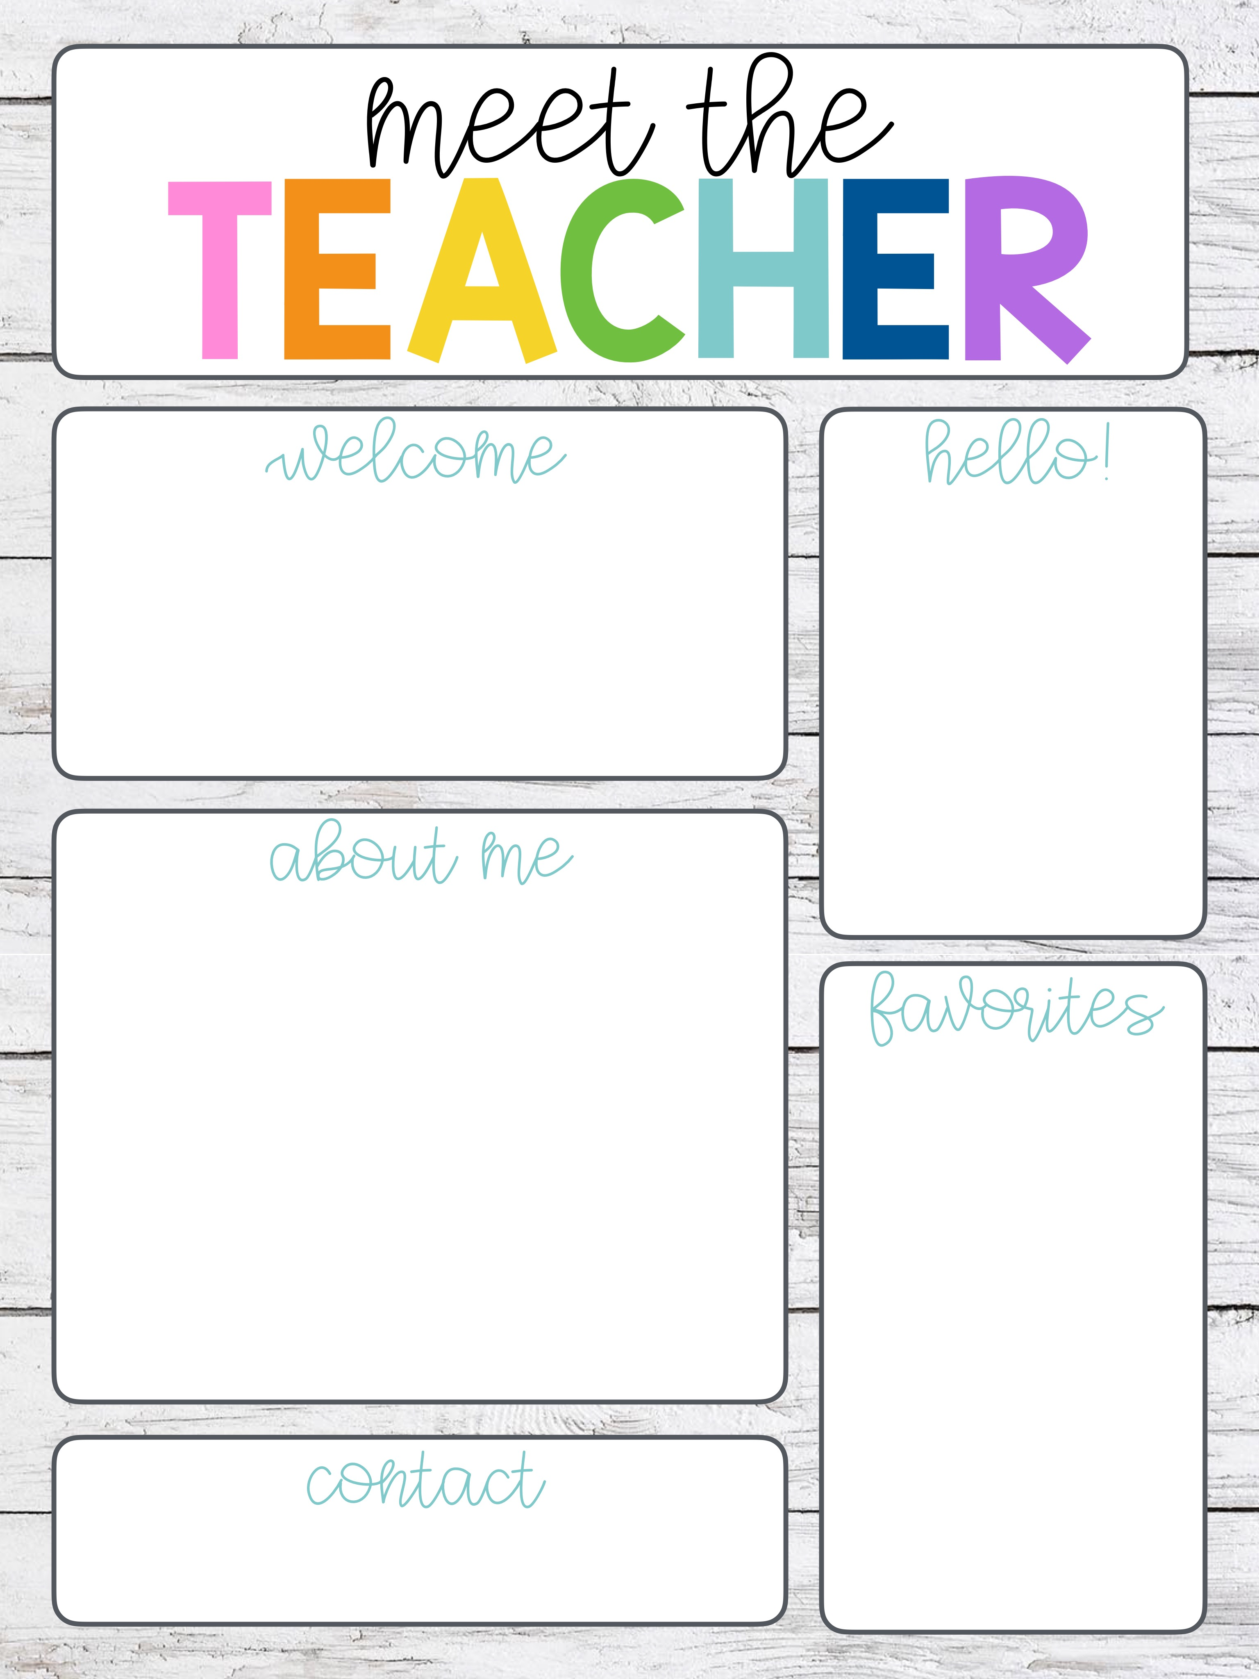
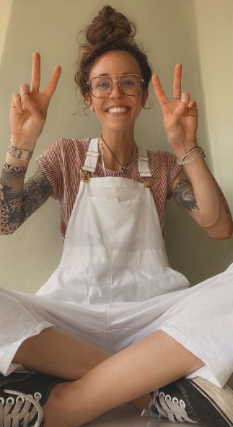
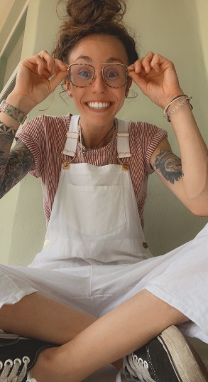
I am beyond excited to learn together this 2025–2026 school year! Our classroom will be filled with hard work, effort, and learning—infused with music, fun, and laughter! Our core values will be kindness, respect, unity, and teamwork. These are just a few tools that will get us across the fifth-grade finish line…together!
This year, I’ll be team teaching with Ms. Carpenter, who will lead the way in ELA and writing while I focus on math and science. We’re not just coworkers—we’re great friends who love working side by side. We bounce ideas off each other constantly, and our partnership brings a fun, supportive energy that our students truly benefit from. You're going to love learning in both of our classrooms!
This is my fifth year at Perkins Elementary, as well as teaching 5th grade, and I could not be more thrilled to have YOU as one of my students! I am an outgoing person and do my best to always carry positive energy. I love working with children and have a passion to create/influence laughter and joy for young people like you! What I am most excited about this year is simply getting to know you. As a teacher, I know that each student is their own special, creative, and unique self; we are all different! Exploring, encouraging, and accepting those differences will be key in our personal and communal growth and success this year! With that being said, enjoy your summer, read some books, get ready for your final elementary adventure,
and I will see you on August 11th!
Color | Pink
Drink | Lemonade
Animal | Shark
Celebrity | JUSTIN BIEBER <3
Hobby | Music, skating, fishing, & beachin’
Sports Team | TB Sports!! Go RAYS, BOLTS, & BUCS!
Subject to Teach | Science
Caffeym@pcsb.org
Subject to Learn | Math

Slide 2
Welcome to my corner of the web! My name is Madison Caffey, and I’m thrilled to be in my fifth year of teaching 5th grade at Perkins Elementary. Originally from Lakeland, Florida, I graduated from St. Petersburg College with my Bachelor's in K-6 EDU in 2021. Education is my passion, and I find immense joy in watching my students grow and thrive.
When I’m not in the classroom, you’ll likely find me indulging in my hobbies. I’m an avid skateboarder, music enthusiast, and basketball player. I also love soaking up the sun at the beach whenever I get the chance. I love the city of St. Pete; its coastal location, energy, spunk, vibrance, and communal unity! While weather can be intense at times, Florida is my home and I do not plan on leaving any time soon.
Thank you for visiting, and I look forward to connecting with you in the classroom! Let’s have a wonderful 2025-2026 school year! GO TIGERS!!

